Slide 1
Class 7: Offer and Acceptance

Slide 2
Key questions
Is there an enforceable promise?
Has it been breached?
Has performance been excused?
How should it be enforced?

Slide 3
Topics
What is an offer?
What constitutes acceptance?
  Ambiguous acceptances
  Acceptance without notification
  Acceptance by part performance
Policy considerations, e.g.:
  Intentions of parties, taking account of risk of judicial error
  Communication costs
  Litigation costs
  Fairness

Slide 4
What is an offer?
Restatement 2d § 24
An offer is the manifestation of willingness to enter into a bargain so made as to justify another person in understanding that his assent to that bargain is invited and will conclude it.
Court routinely distinguish quotes and ‘invitations to treat’ from offers.
  See e.g., Leonard v. Pepsico.
Statements that are not offers may be tortious or violations of consumer protection statutes.

Slide 5
Lefkowitz v. Great Minneapolis (200)
Why are advertisements not usually treated as offers?
Is it reasonable to rely on advertisements?
Were these advertisements offers? Why?
Were the offers accepted?
How will Great Minneapolis respond?

Slide 6
What constitutes acceptance?
An acceptance is a manifestation of assent to the terms of an offer.
The offer may define what qualifies as acceptance – ‘the offeror is master of the offer.’
An acceptance must be on the same terms as the offer and must be unconditional.
Acceptance may involve either a promise or performance.
Silence ordinarily is not acceptance.
Acceptance is effective upon dispatch by reasonable means (except in the case of options).
Notification of acceptance by promise is ordinarily required.

Slide 7
Notification of acceptance by performance
§ 54 Acceptance by Performance; Necessity of Notification to Offeror
(1) Where an offer invites an offeree to accept by rendering a performance, no notification is necessary to make such an acceptance effective unless the offer requests such a notification.
(2) If an offeree who accepts by rendering a performance has reason to know that the offeror has no adequate means of learning of the performance with reasonable promptness and certainty, the contractual duty of the offeror is discharged unless
(a) the offeree exercises reasonable diligence to notify the offeror of acceptance, or
(b) the offeror learns of the performance within a reasonable time, or
(c) the offer indicates that notification of acceptance is not required.

Slide 8
Termination of the power of acceptance
Lapse
  If no period is specified in the offer, it lapses after a reasonable time.
Revocation
Rejection/counter-offer
Death or supervening incapacity of the offeror
Note that the last three events may not terminate the power to accept an irrevocable offer.

Slide 9
Wucherpfennig v. Dooley (214)
Jan. 4: “Now if Donald wants to buy my share of the real estate I will sell it to him for $200 an acre, provided it is a cash deal & handled promptly.”
Jan. 13: Donald “interested.”
Feb. 17: “…we are therefore ready to proceed with this transaction. Please let me know the exact dollar amount that you expect to receive…”
March 9: Revocation
Was the initial letter an offer?
Was the letter of Feb. 17 an acceptance?

Slide 10
Problem: Awesome Acceptance? (221)
pedramcx (2:50:08 PM): We can do 2000 orders/day by Friday if I have your blessing
…
pedramcx (2:52:13 PM): those 2000 leads are going to be generated by our best affiliate and he's legit
…
nicktouris (4:43:09 PM): NO LIMIT
pedramcx (4:43:21 PM): awesome!
What was the offer? Was there an acceptance?
Should it be possible to modify a contract by IM?

Slide 11
International Filter Co. v. Conroe, Gin, Ice & Light (217)
“This proposal…becomes a contract when accepted by the purchaser and approved by an executive officer of the International Filter company…This proposal is submitted for prompt acceptance...”
Who was the offeror?
What constituted acceptance?
Why this form of acceptance?
Was notification of acceptance required?
Was notification of acceptance provided?
Would the letter on its own qualify as acceptance?

Slide 12
White v. Corlies & Tift (222)
Sequence of events: Specifications, estimate, change in specifications, revised estimate (signed), note, beginning of performance, countermand.
“Upon an agreement to finish the fitting up of offices 57 Broadway in two weeks from date, you can begin at once.
The writer will call again, probably between 5 and 6 this p.m.”
What was the offer?
What sort of acceptance was sought?
Did the offeror dispense with notification of acceptance?

Slide 13
Notification of acceptance by performance
§ 54 Acceptance by Performance; Necessity of Notification to Offeror
(1) Where an offer invites an offeree to accept by rendering a performance, no notification is necessary to make such an acceptance effective unless the offer requests such a notification.
(2) If an offeree who accepts by rendering a performance has reason to know that the offeror has no adequate means of learning of the performance with reasonable promptness and certainty, the contractual duty of the offeror is discharged unless
(a) the offeree exercises reasonable diligence to notify the offeror of acceptance, or
(b) the offeror learns of the performance within a reasonable time, or
(c) the offer indicates that notification of acceptance is not required.

Slide 14
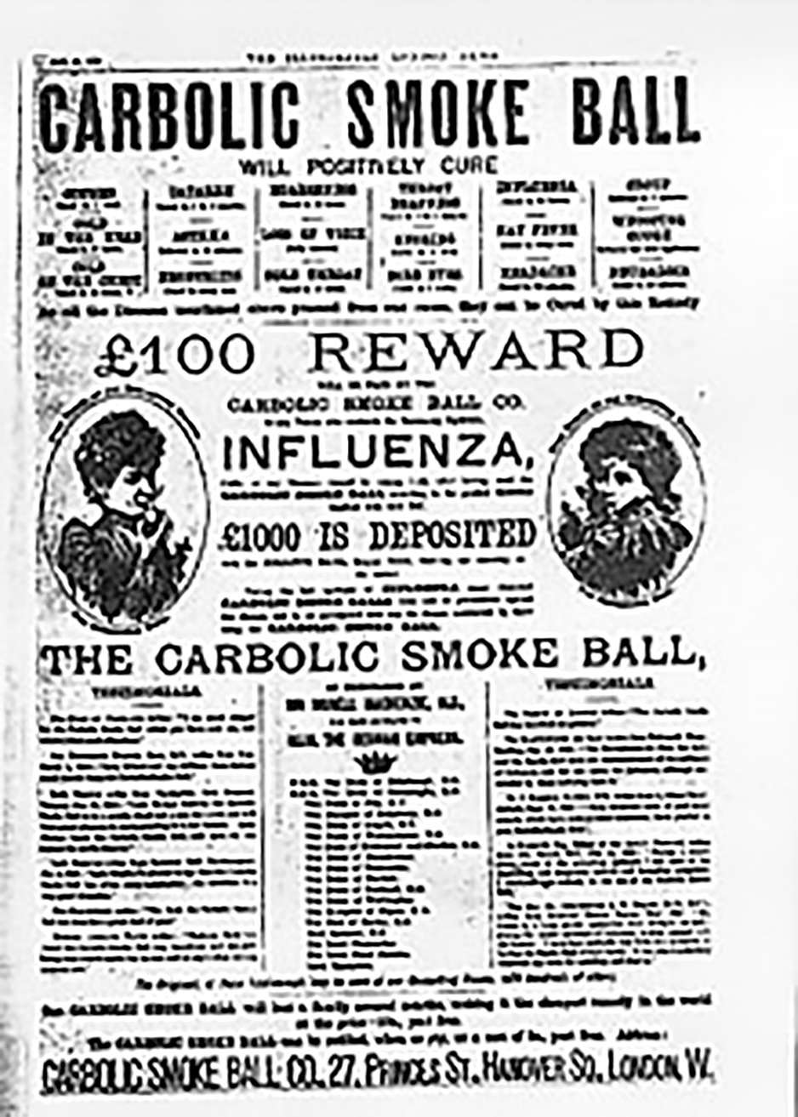

Slide 15
Carlill v. Carbolic Smoke Ball (228)
“£100 reward will be paid by the Carbolic Smoke Ball Company to any person who contracts the influenza after having used the ball three times daily for two weeks according to the printed directions supplied with each ball...£1000 is deposited with the Alliance Bank, shewing our sincerity in the matter.”
Was the advertisement an offer?
Could it be revoked before Mrs. Carlill notified them of her claim?
Could it be revoked after she bought the smoke ball but before she had used it as directed? Before she contracted influenza?
What was the consideration?

